Slide 1
Metabolic Diseases Lesson 4.3/4.4
Why are there contradictory messages about ‘good’ and ‘bad’ foods?

Slide 2
Do Now
What type of diets have you heard about?
What is an example of conflicting nutrition claims?

Slide 3
Atkins vs. Mediterranean Diet
What is the Atkins diet?
What is the Mediterranean diet?

Slide 4
Atkins Diet
Mediterranean
Diet
No sugars or carbohydrates!
Unlimited fat and protein
No saturated fats!
No trans-unsaturated fats!
Unsaturated fats are OK.

Slide 5
Fats
Saturated fats:
Animal fats
Always solid
Cis unsaturated fats:
Plant oils
Usually liquid
Trans unsaturated fats:
Don’t occur naturally
Usually solid

Slide 6
Atkins Diet
Mediterranean
Diet
No sugars or carbohydrates!
Unlimited fats and protein
No saturated fats!
No trans-unsaturated fats
Some unsaturated fats are OK.
How can they both be healthy?

Slide 7
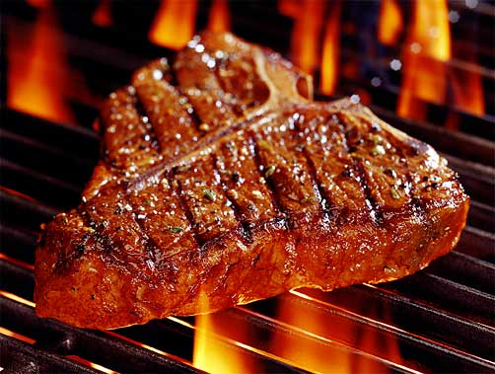
Worksheet 4.3 Diets: Which One is Best?
The “Atkins” diet was developed 40 years ago with the purpose of controlling satiety by increasing consumption of fats and protein while severely limiting consumption of carbohydrates and sugars. While this diet has become very popular in Western countries, many people have questioned whether it can be healthy.
On the other hand, the "Mediterranean" diet, entails eating foods that substitute unsaturated fats found in plant oils and Omega 3 fatty acids for saturated fats. Advocates of this diet argue that consumption of saturated fats, commonly found in foods of animal origin high in protein and fat, and encouraged in the Atkins diet, will lead to an increased risk of cardiovascular disease

Slide 8
Diets: Which One is Best?
Based on your understanding of nutrition and metabolism, what hypothesis would you make about the health consequences of the two diets?
How would you set up an experiment to test your hypothesis?
Who would you include in the study?
What would the conditions of the study be?
What would you measure?

Slide 9
Two studies evaluated the diets
The two publications we will study examined two cohorts of people based upon their adherence to an Atkins-like diet or a Mediterranean style diet. Both publications examined the relationship between the diet and cardiovascular diseases.
.

Slide 10
Based on your hypothesis what would you predict?
Draw a bar graph showing the results you would expect to see if your hypothesis is correct.
Prepare to discuss your graph with the rest of the class and provide reasoning for the relationship between diet and cardiovascular disease.

Slide 11
Real data from two studies!
What does the data suggest?
Is this consistent with your predictions? If not, why might this be?
What additional information would allow you to make more conclusions about the data?

Slide 12
Two studies evaluated the diets
The two publications we are studying examined two cohorts of people based upon their adherence to an Atkins-like diet or a Mediterranean style diet. Both publications examined the relationship between the diet and cardiovascular diseases.
How would you determine how well someone adhered to the diets?
.

Slide 13
Stop here!

Slide 14
Predict the next result
Note there are two Y-axes on the graph, one for Mediterranean and one fore Atkins. Draw a line graph showing the results you would expect to see if your initial hypothesis was correct.
Prepare to discuss your predictions with the class.

Slide 15
Real data from two studies!
How does diet adherence affect health outcomes?
Is this consistent with your initial prediction?
Do the new results affect the initial data at all?

Slide 16
Real data from two studies!
If we use one axis to draw the same graph we can see the the Mediterranean diet group had a far higher CVD incidence to begin.
Diet Adherence
Notes:
Similar to the data in the bar graph, people in the Mediterranean diet group still had way higher incidence of CVD.

Slide 17
Who did the studies use as subjects?
The Atkins diet cohort study examined a population of 49,261 Swedish women aged 30-49 living around the Uppsala region who responded to a questionnaire that was mailed out to 96,000 total women.
The Mediterranean diet study examined two cohorts of Dutch people.
The MORGEN cohort was 22,654 Dutch men and women aged 20-65 who were recruited through random population sampling in Amsterdam, Maastricht, and Doetinchem.
The second cohort, PROSPECT, was 17,357 Dutch women aged 50-70 who participated in a breast cancer screening program.
In all cohorts, any individuals who had pre-existing conditions for cardiovascular disease were removed from this study. Food and drink intake was assessed by survey in all three cohorts, and subgroups were organized based upon degree of adherence to a certain diet.

Slide 18
Who did the studies use as subjects?
How might the experimental design be improved to make the results from the 2 groups more comparable?

Slide 19
Wrap Up
Do we need to re-evaluate what we know about how fat metabolism contributes to health?
Why do you think nutritional messages are always changing?

Slide 20
Homework
Complete the Lesson 4.3/4.4 Worksheet.

